Slide 1


Buy vs Build
In the Age of Vibe Coding
John Blackburn
Manager, VoTech Recruiting, LLC

Slide 2

Introductions
Who Am I?
Worked as a Teacher in Jax at Paxon while in Grad School
Degrees in Physics (BS) and Mathematics (MS) from UNF
12 Years experience building new systems and integrating old nasty ones together
I love solving problems for people and companies!
Recently left Suddath as an Application Architect
Diving full time into VoTech Recruiting
and launching Flat Rate Dev
© VoTech Recruiting, LLC, All Rights Reserved

Slide 3
Who is VoTech Recruiting?
What we do
Recruiting
By Developers.
For Developers.
Pay for Software,
Not Hours.
© VoTech Recruiting, LLC, All Rights Reserved

Slide 4
This talk, in one sentence.
If you remember nothing else
Every Company
is a Technology Company
© VoTech Recruiting, LLC, All Rights Reserved

Slide 5

How can that be?
What about:
A Bank
Software Company with a banking license
© VoTech Recruiting, LLC, All Rights Reserved
Notes:
Chase looks like a traditional bank, but it increasingly operates like a massive financial technology platform with a banking charter. The customer experience is driven by mobile banking, online account opening, payments, fraud detection, personalization, AI, data infrastructure, and continuous app delivery. Chase’s own technology page describes technology and data as central to how the firm transforms businesses and serves customers.

Slide 6

How can that be?
What about:
Software Company that also makes pizza
© VoTech Recruiting, LLC, All Rights Reserved
Notes:
A real-time ordering, routing, loyalty, and ETA prediction company that happens to sell pizza. Domino’s now talks openly about DomOS, its proprietary operating system, and AI-powered order tracking.

Slide 7
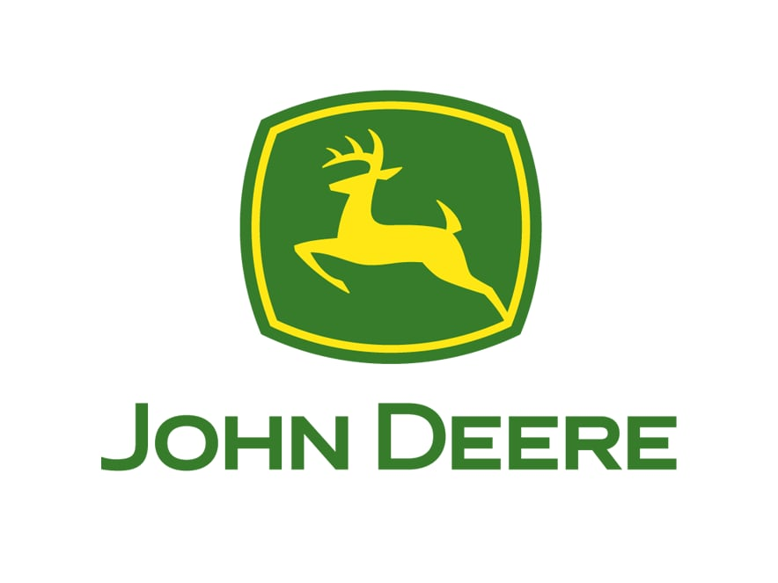
How can that be?
What about:
Software Company that also sells tractors
© VoTech Recruiting, LLC, All Rights Reserved
Notes:
A precision-agriculture data platform with tractors. Deere’s Operations Center is an online farm management system accessible by web, tablet, or phone, and it connects with outside software companies.

Slide 8

How can that be?
What about:
Software Company with a lot of brown trucks
© VoTech Recruiting, LLC, All Rights Reserved
Notes:
An operations-research and route-optimization company with brown trucks. UPS built ORION to use data and predictive models to improve routing efficiency.

Slide 9
Cost of Tech-Phobia
Too Slow
Competitors
Quote faster
Onboard faster
Integrate faster
Solve problems faster
© VoTech Recruiting, LLC, All Rights Reserved

Slide 10
Cost of Tech-Phobia
Too Expensive
The hidden tax of
Manual work
Spreadsheets
Emails
Meetings,
Tribal knowledge
© VoTech Recruiting, LLC, All Rights Reserved

Slide 11
Cost of Tech-Phobia
Too Hard to Work With
Customers expect
Portals
Visibility
Clean data
Integrations
Tracking, dashboards
Self-service
© VoTech Recruiting, LLC, All Rights Reserved

Slide 12
Cost of Tech-Phobia
Unable to Adapt
Your business cannot
Move when the market moves
Pivot during catastrophes
© VoTech Recruiting, LLC, All Rights Reserved

Slide 13
Today’s Discussion
Competitors quote faster, onboard faster, integrate faster, and solve problems faster.
The real question is not
whether you need technology. You do.
The real question is:
which should you own?
which should you rent?
& which should you stitch together?
© VoTech Recruiting, LLC, All Rights Reserved

Slide 14
Those questions are all old, what’s new here?
Competitors quote faster, onboard faster, integrate faster, and solve problems faster.
AI (LLMs) models has changed the game!
The next answer to the problem of
“how do we talk to machines?”
© VoTech Recruiting, LLC, All Rights Reserved

Slide 15
AI has changed the game!
Competitors quote faster, onboard faster, integrate faster, and solve problems faster.
[Begin live demo]
© VoTech Recruiting, LLC, All Rights Reserved

Slide 16
While we’re waiting…
When to Buy
When to Build
When to Stitch
What is “Vibe Coding”?
How LLMs have moved the line
Examples
Conclusions
© VoTech Recruiting, LLC, All Rights Reserved

Slide 17
Buy the Platform
Buy
Build
Stitch
Vibe Coding
AI Moved the Line
Examples
Conclusions
Buy when the problem is
known
boring
well-entrenched
industry-standard
and not where your edge lives
© VoTech Recruiting, LLC, All Rights Reserved

Slide 18
Buy the Platform
Buy
Build
Stitch
Vibe Coding
AI Moved the Line
Examples
Conclusions
Good Buy Candidates
Accounting and billing
Payroll
CRM
Core WMS, TMS, OMS
Inventory transaction system
Payment processing
Compliance-heavy workflows
Industry-standard reporting
© VoTech Recruiting, LLC, All Rights Reserved

Slide 19
Buy the Platform
Buy
Build
Stitch
Vibe Coding
AI Moved the Line
Examples
Conclusions
Buy when the problem is core to operating,
but not core to differentiating.
Unless your edge is inventing a better WMS
just go pick one up at the store
© VoTech Recruiting, LLC, All Rights Reserved

Slide 20
Buy the Platform
Buy
Build
Stitch
Vibe Coding
AI Moved the Line
Examples
Conclusions
There will be times when buying hurts
Options are bad, clunky, painful
Pricing creates a high barrier to entry
Platform does 80% of what you need, but the last 20% matters
Vendor roadmap does not match your business roadmap
Inventory transaction system
system makes you operate like everyone elseCompliance-heavy workflows
© VoTech Recruiting, LLC, All Rights Reserved

Slide 21



Buy the Platform
Buy
Build
Stitch
Vibe Coding
AI Moved the Line
Examples
Conclusions
Remember…
No software is forever
Plan to graduate as your needs change
Do not rewrite double-entry accounting* just because you use it
*See also: when to rewrite double-entry accounting
© VoTech Recruiting, LLC, All Rights Reserved

Slide 22
Build the Edge
Buy
Build
Stitch
Vibe Coding
AI Moved the Line
Examples
Conclusions
Build when it differentiates you
Not because you can
Not because AI made it cheaper
Not because the buy-it screen is ugly
Build when that custom capability
helps you win
© VoTech Recruiting, LLC, All Rights Reserved

Slide 23
Build the Edge
Buy
Build
Stitch
Vibe Coding
AI Moved the Line
Examples
Conclusions
The seduction of “mine”
“We can do that better”
“We can do that cheaper”
“We don’t need all that junk that comes with ______”
“We can always sell our software to our competitors”
“We get all those R&D Tax Credits”
© VoTech Recruiting, LLC, All Rights Reserved

Slide 24
Build the Edge
Buy
Build
Stitch
Vibe Coding
AI Moved the Line
Examples
Conclusions
Good Build Candidates
Customer portals
Exception workflows
Custom pricing or quoting logic
Operational dashboards
Client onboarding tools
Decision-support tools
Workflow automation
AI copilots around your business knowledge
© VoTech Recruiting, LLC, All Rights Reserved

Slide 25
Build the Edge
Buy
Build
Stitch
Vibe Coding
AI Moved the Line
Examples
Conclusions
Build, only when you are prepared to own
Maintenance
Support
Security
Testing
Documentation
Training
Integrations
Uptime
Future changes
© VoTech Recruiting, LLC, All Rights Reserved

Slide 26
Stitch Together Solutions
Buy
Build
Stitch
Vibe Coding
AI Moved the Line
Examples
Conclusions
Hybrid solutions are often the right answer
Buy the platform(s)
Build your edge
Build the integrations
© VoTech Recruiting, LLC, All Rights Reserved

Slide 27
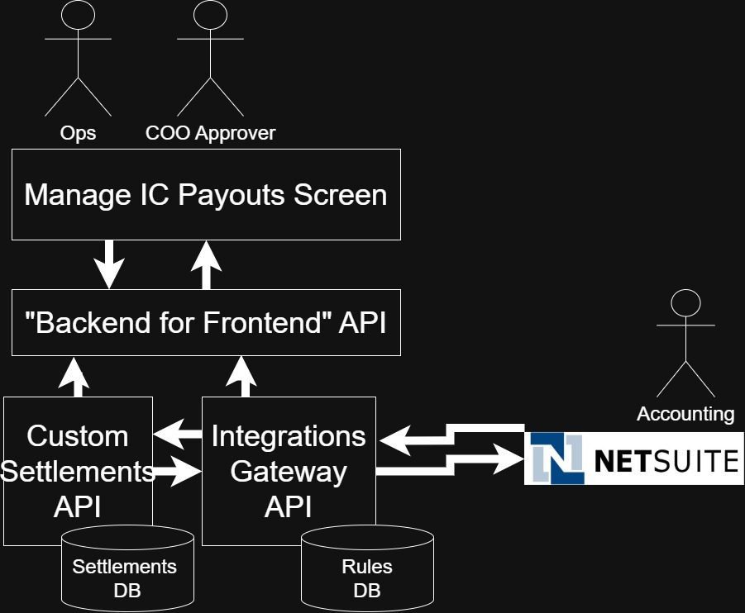
Stitch Together Solutions
Buy
Build
Stitch
Vibe Coding
AI Moved the Line
Examples
Conclusions
© VoTech Recruiting, LLC, All Rights Reserved

Slide 28
What is “Vibe Coding”
Buy
Build
Stitch
Vibe Coding
AI Moved the Line
Examples
Conclusions
My Definition
Building systems, integrations, or automated software tools using AI assisted tools and
having no concern for
What code was written
How it works
What Its limitations are
© VoTech Recruiting, LLC, All Rights Reserved

Slide 29
What is “Vibe Coding”
Buy
Build
Stitch
Vibe Coding
AI Moved the Line
Examples
Conclusions
Let’s Differentiate
Vibe Coding <> AI Assisted Software Development
Use the Pareto Principal (80/20 Rule) to decide the difference
© VoTech Recruiting, LLC, All Rights Reserved

Slide 30
What is “Vibe Coding”
Buy
Build
Stitch
Vibe Coding
AI Moved the Line
Examples
Conclusions
80/20 Rule
Vibe Coding
20 % Human Thinking / 80 % AI Assisted
AI Assisted Software Development
80 % Human Thinking / 20 % AI Assisted
© VoTech Recruiting, LLC, All Rights Reserved

Slide 31
What is “Vibe Coding”
Buy
Build
Stitch
Vibe Coding
AI Moved the Line
Examples
Conclusions
An Analogy: GPS
Google Maps is to geo-navigators
as LLMs are to software navigators
© VoTech Recruiting, LLC, All Rights Reserved

Slide 32
What is “Vibe Coding”
Buy
Build
Stitch
Vibe Coding
AI Moved the Line
Examples
Conclusions
An Analogy: GPS
It can read and plan faster than you can
It can compile multiple sources of data
It can quickly answer the question of “how”
© VoTech Recruiting, LLC, All Rights Reserved

Slide 33
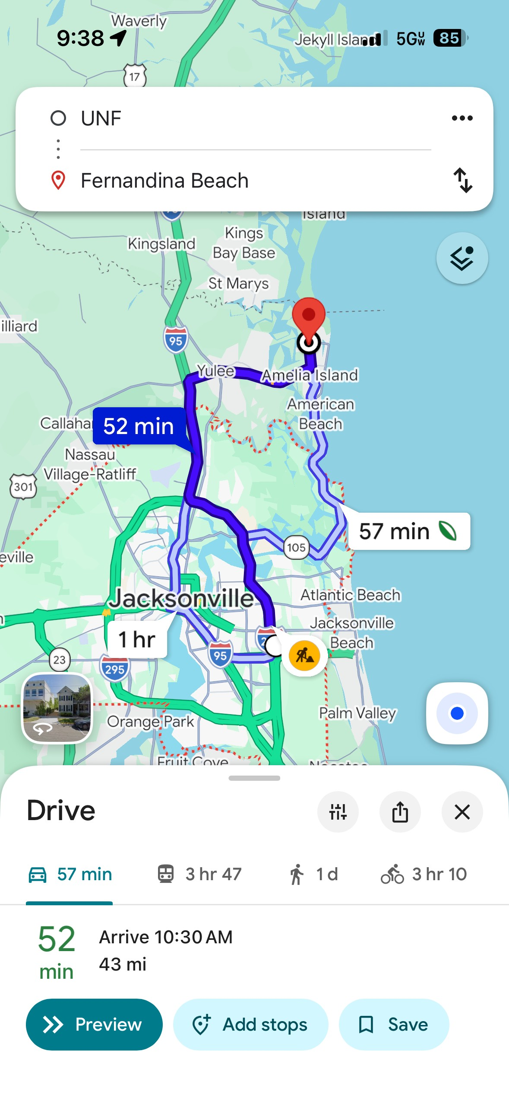
What is “Vibe Coding”
Buy
Build
Stitch
Vibe Coding
AI Moved the Line
Examples
Conclusions
An Analogy: GPS
You say “Fernandina Beach”
© VoTech Recruiting, LLC, All Rights Reserved

Slide 34
How AI Moved the Buy/Build Line
Buy
Build
Stitch
Vibe Coding
AI Moved the Line
Examples
Conclusions
The answer to “Can we do this?”
Has always been:
Yes!
We can do anything.
The real questions are: “how long”
and “how much?”
© VoTech Recruiting, LLC, All Rights Reserved

Slide 35
How AI Moved the Buy/Build Line
Buy
Build
Stitch
Vibe Coding
AI Moved the Line
Examples
Conclusions
AI is changing “how long” and “how much”
[Return to live demo]
© VoTech Recruiting, LLC, All Rights Reserved

Slide 36
How AI Moved the Buy/Build Line
Buy
Build
Stitch
Vibe Coding
AI Moved the Line
Examples
Conclusions
The calculus has changed for the upfront “Build”
But… remember Build, only when you are prepared to own:
Maintenance
Support
Security
Testing
Documentation
Training
Integrations
Uptime
Future changes
© VoTech Recruiting, LLC, All Rights Reserved

Slide 37
Examples
Buy
Build
Stitch
Vibe Coding
AI Moved the Line
Examples
Conclusions
[Return to live demo]
© VoTech Recruiting, LLC, All Rights Reserved

Slide 38
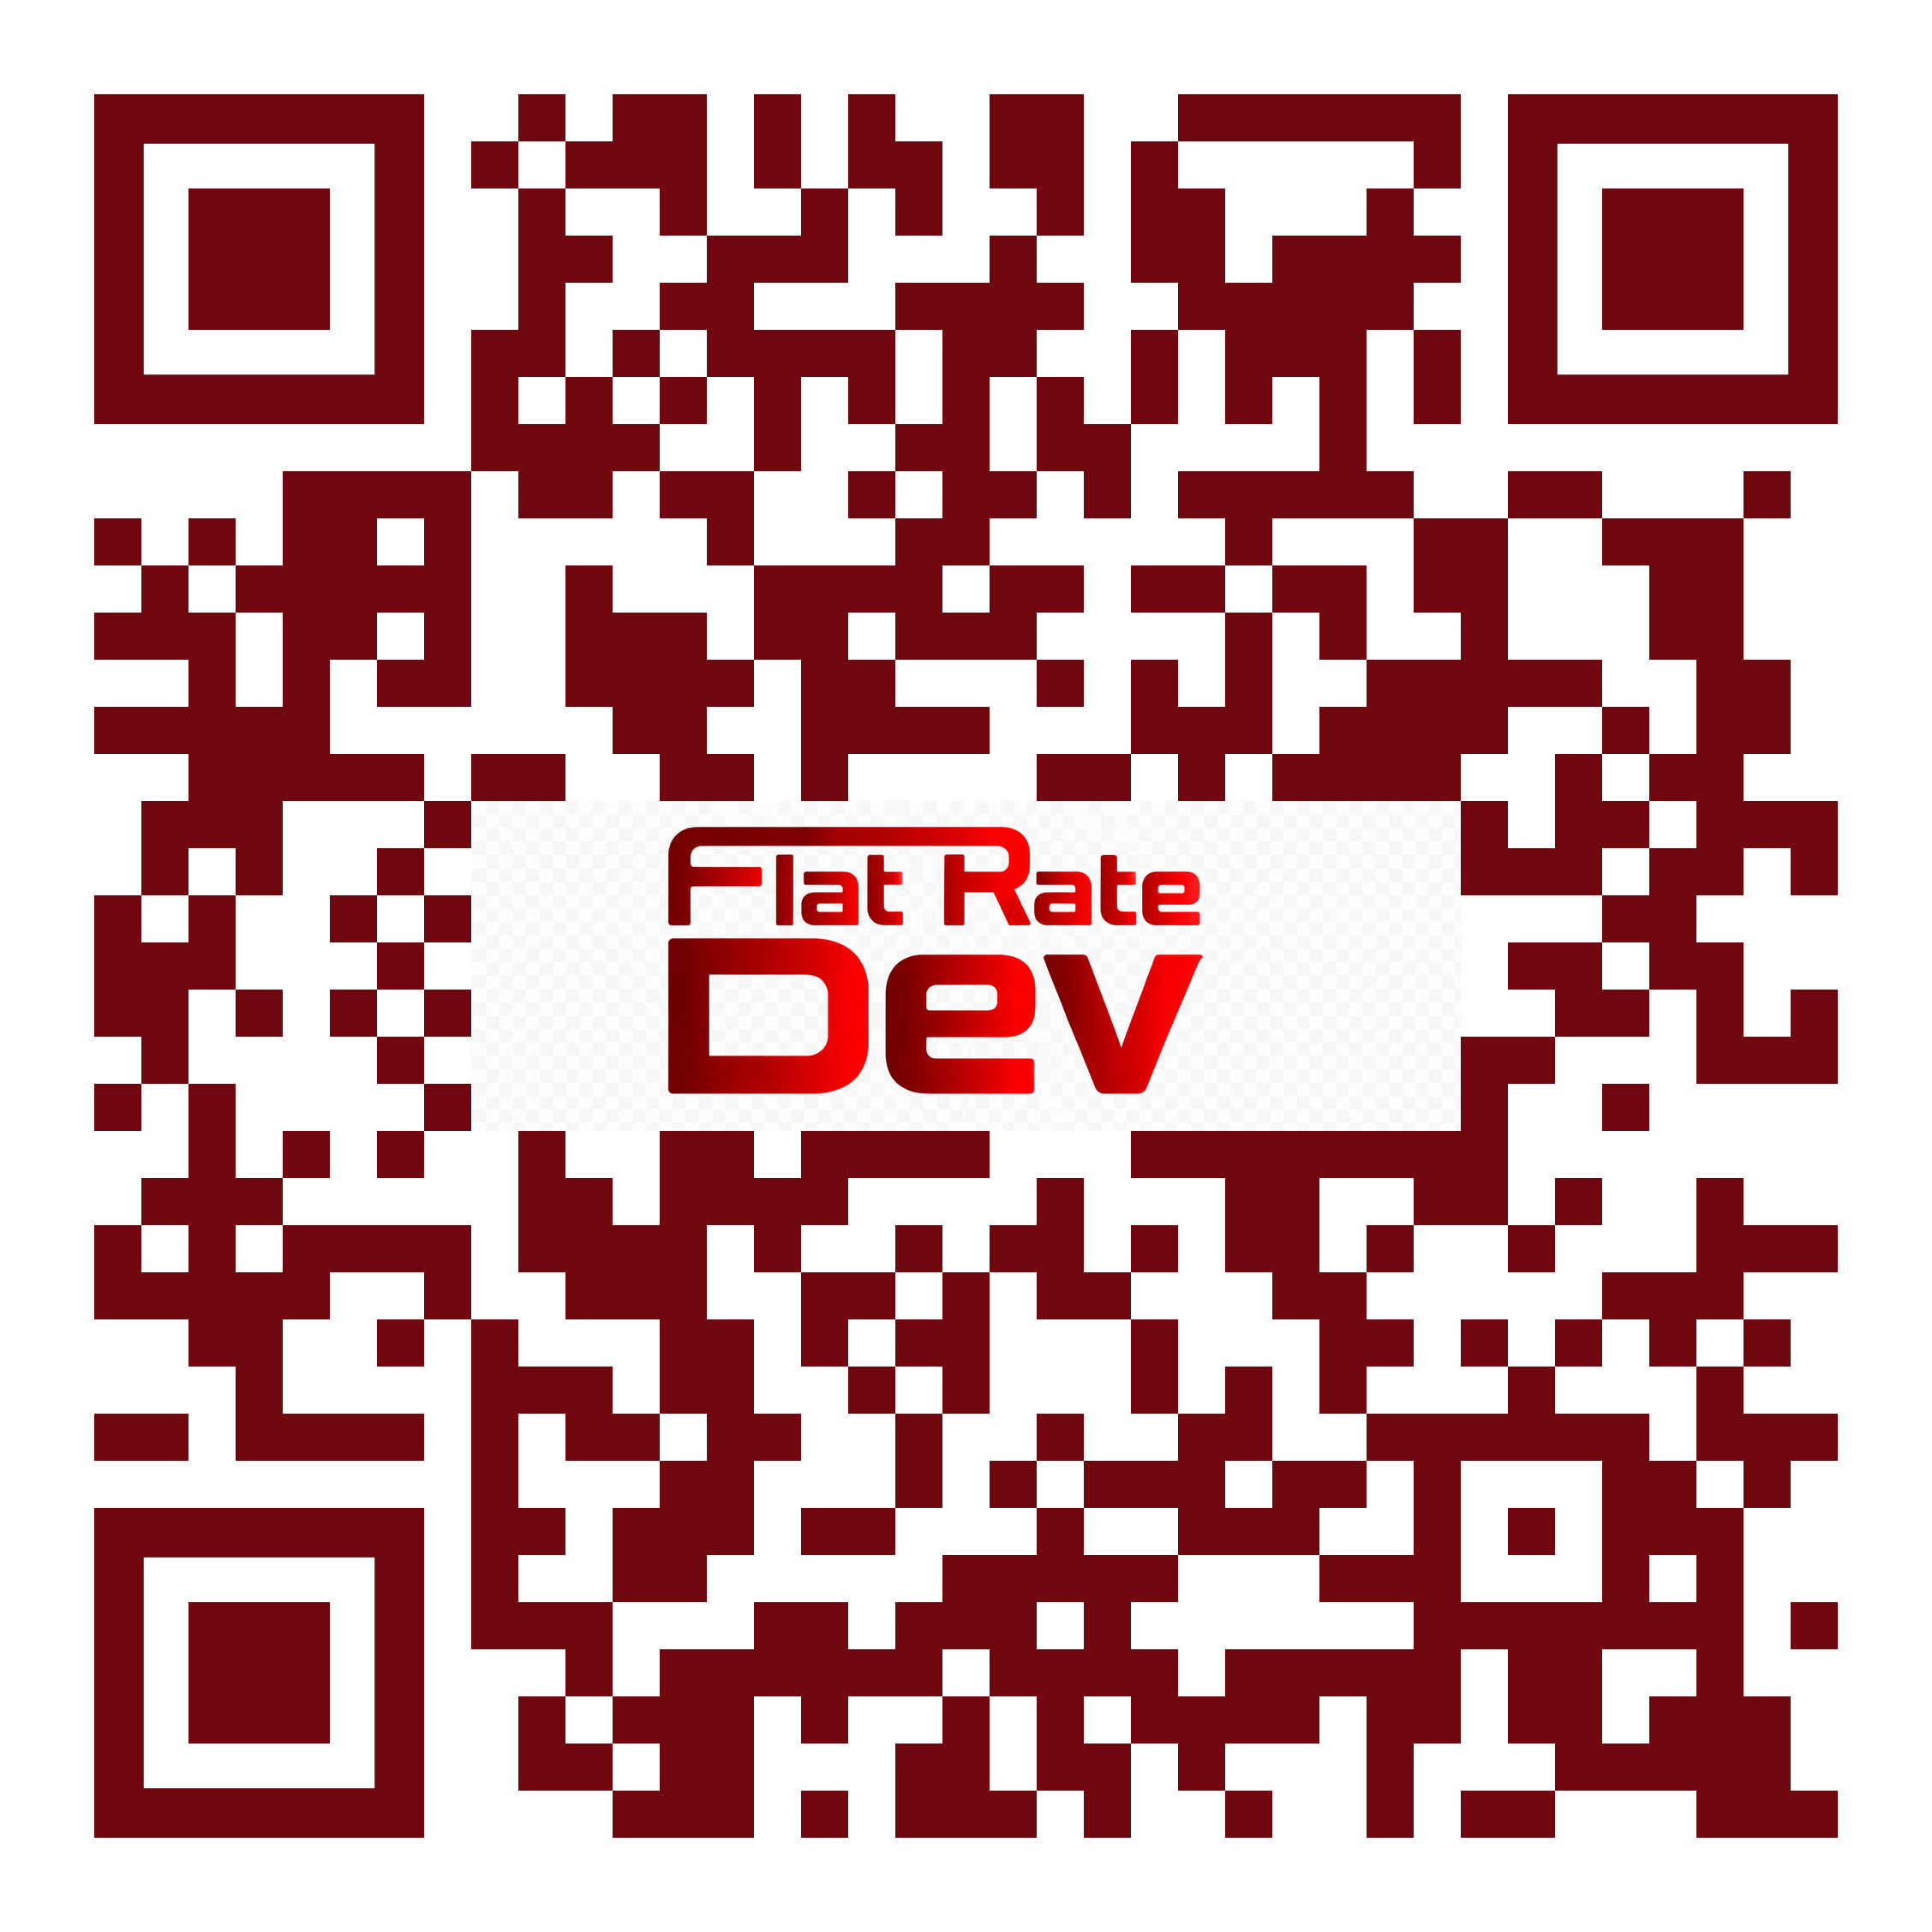
Examples
Buy
Build
Stitch
Vibe Coding
AI Moved the Line
Examples
Conclusions
Check out our vibe coded app live here
© VoTech Recruiting, LLC, All Rights Reserved

Slide 39
Conclusions
Buy
Build
Stitch
Vibe Coding
AI Moved the Line
Examples
Conclusions
This talk is about “Buy” vs “Build”
A better way to think of it is “Rent” vs. “Own”…
Rent (“Buy”) when….
Own (“Build”) when….
The tech is a liability
You want turn-key process
You can color inside the lines
This is not what makes you special
The tech is an asset
You want YOUR process
You can’t work on the software’s roadmap
Your customer views your tech as
Value Add
© VoTech Recruiting, LLC, All Rights Reserved

Slide 40


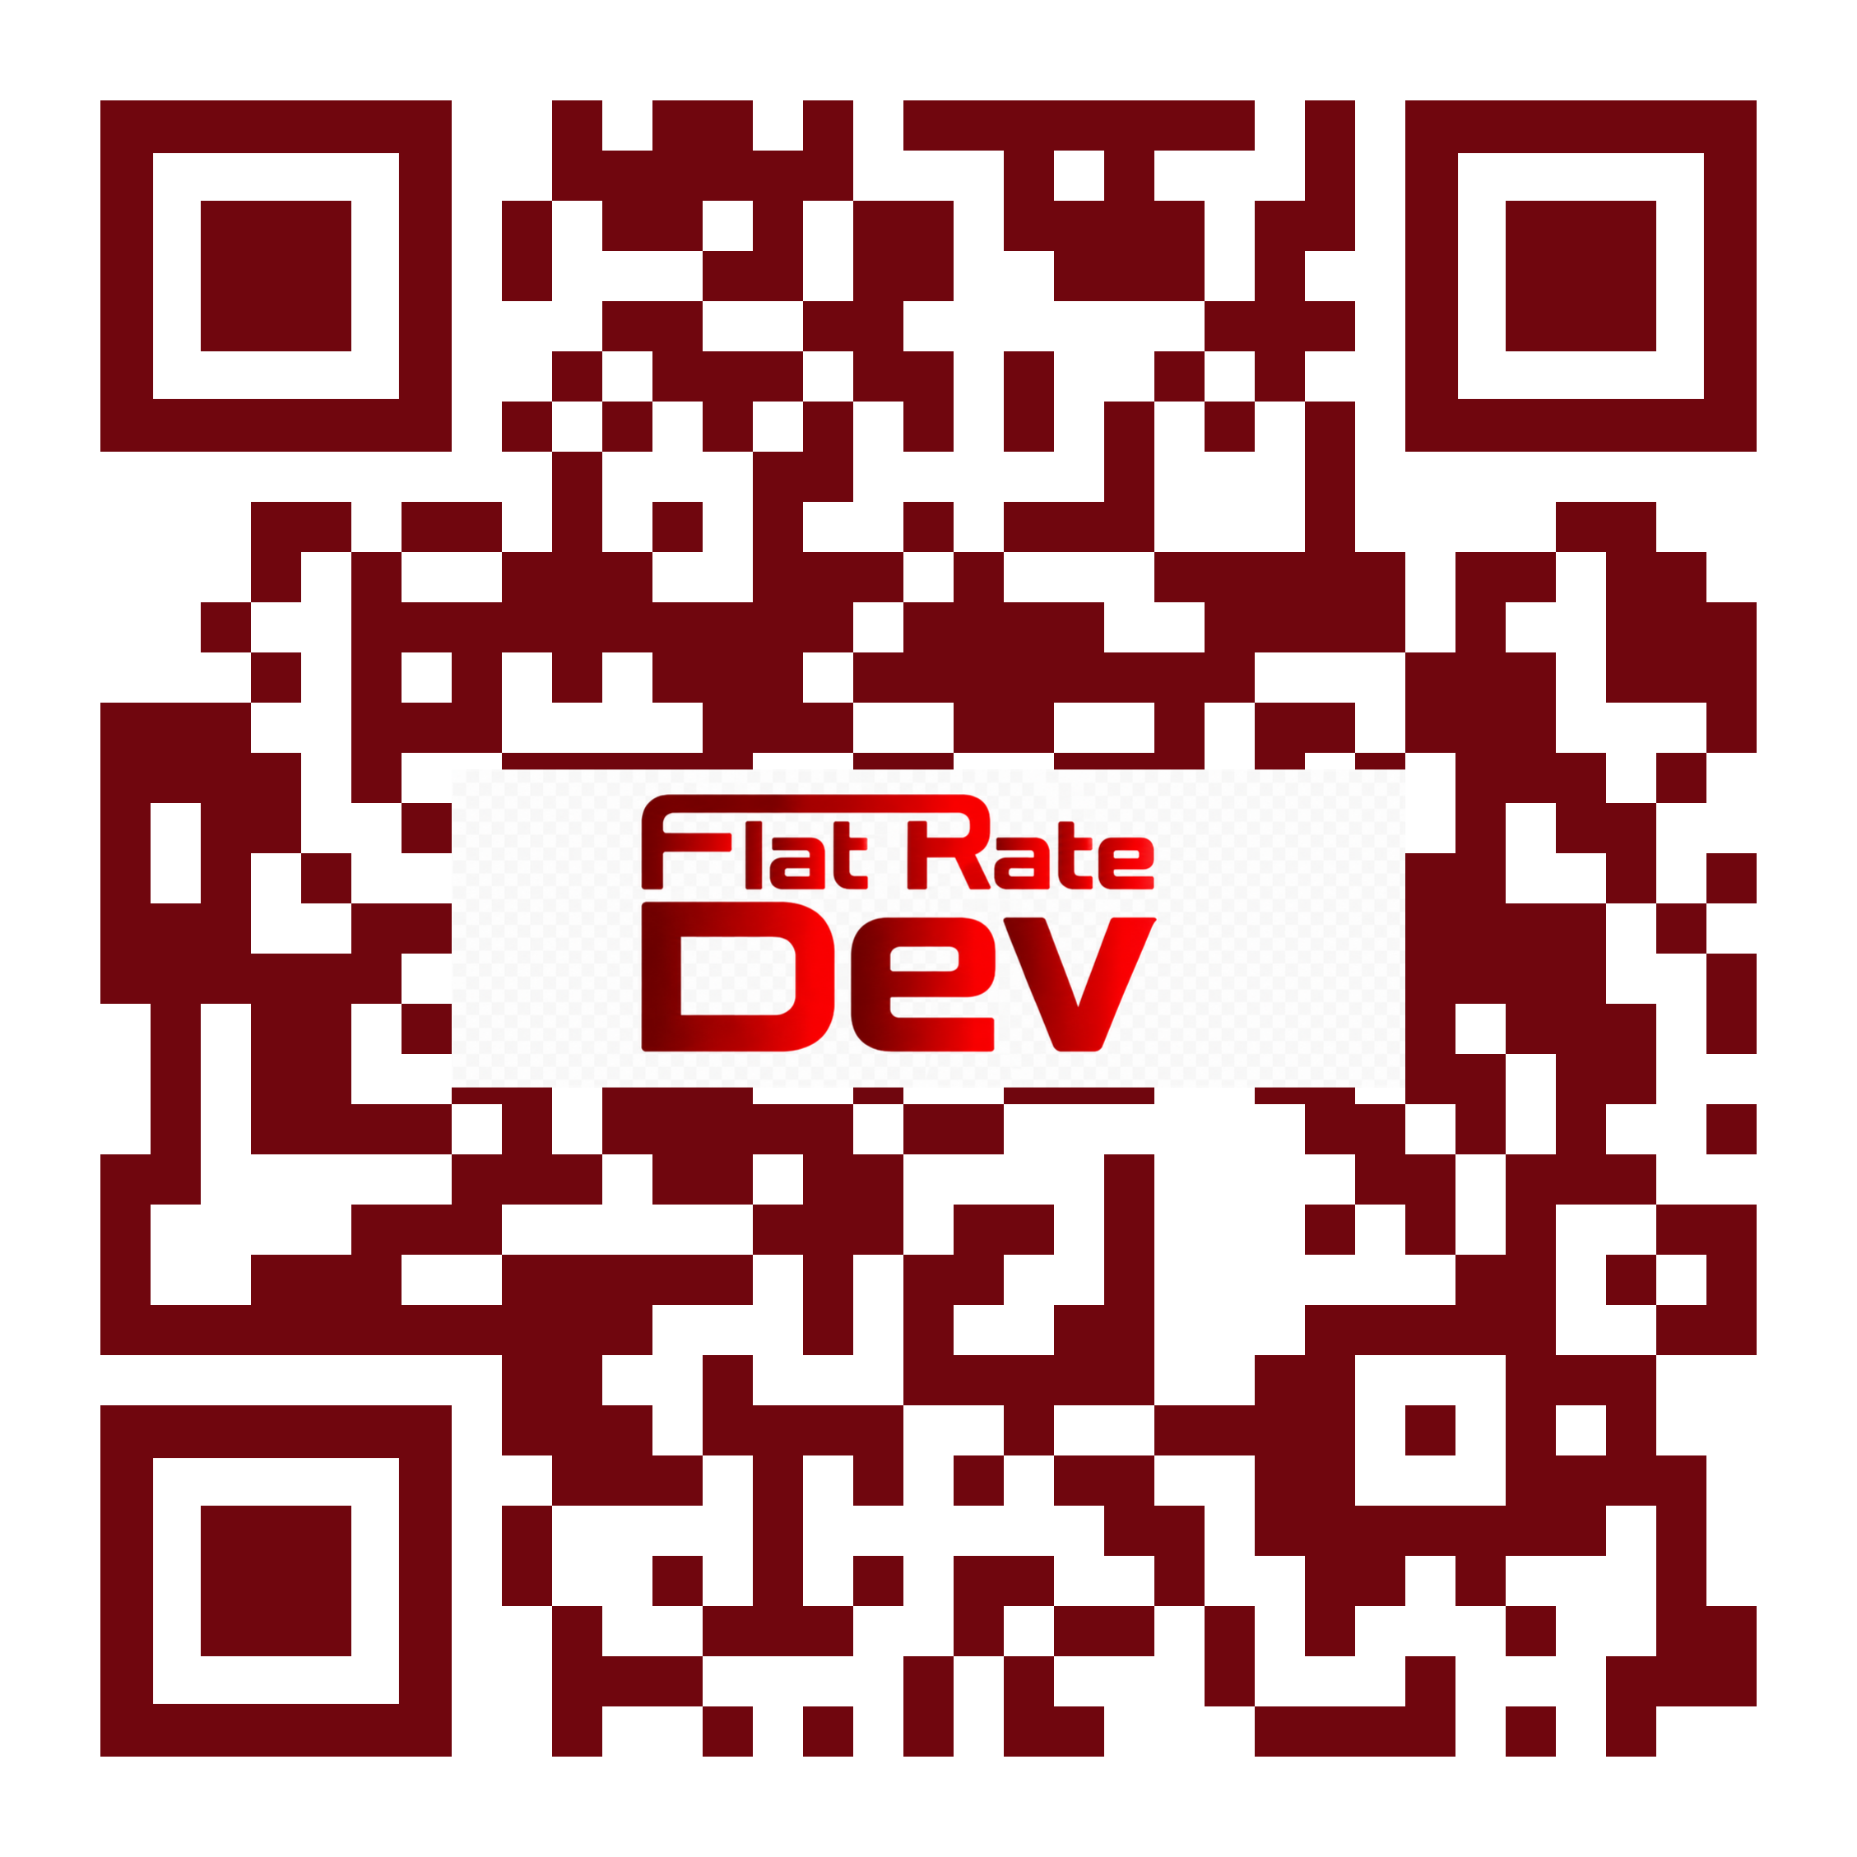
Questions/Comments/Concerns
Today’s Example Code
Connect with Me
Book a Free Call
© VoTech Recruiting, LLC, All Rights Reserved

